Slide 1
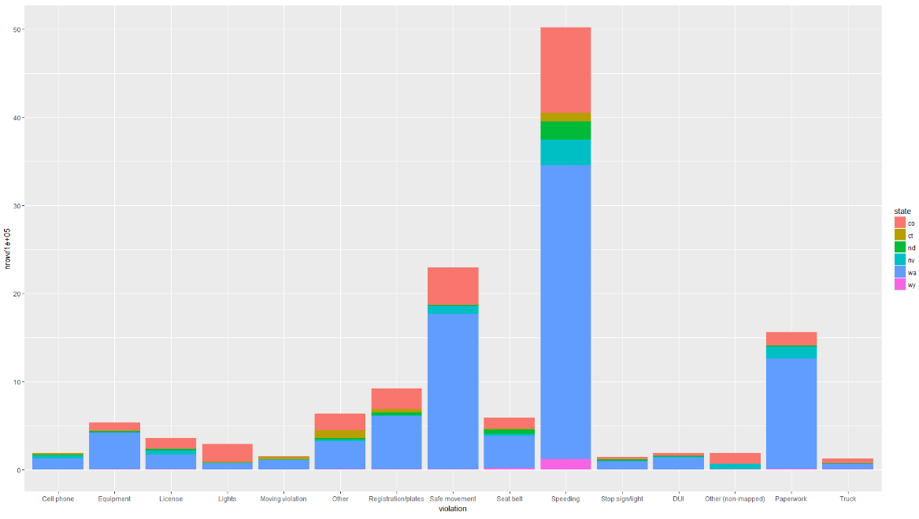
Report – 16/04/2018: Stanford Policing Dataset
In-scope states
5 states including Speeding, Cell Phone, DUI relevant records (Top 3 causes of car accident in USA: speeding, cell phone (text, calling), DUI)
Target 3 states firstly that share the majority of the violation: Colorado (pink) , Nevada (Aqua), Washington (Blue)

Slide 2
Part I
Relevant Demographic Statics
Age Group Distribution in the licensed driver
Age Group Distribution in the traffic offender

Slide 3
Demographic Overview
State | Population | Licensed Driver | Offenders | % LD ~ P | % O ~ LD | Year
Colorado | 5,029,196 | 3,779,273 | 481,434 | 75.15 | 12.74 | 2010
Nevada | 2,700,551 | 1,728,060 | 138,130 | 63.99 | 7.99 | 2013
Washington | 6,724,540 | 5,026,521 | 1,246,132 | 74.75 | 24.79 | 2009
State | Population | Licensed Driver | Offenders | % LD ~ P | % O ~ LD | Year
Colorado | 5,456,574 | 3,974,521 | 410,479 | 72.84 | 10.33 | 2015
Nevada | 2,890,845 | 1,835,511 | 216,477 | 63.49 | 11.79 | 2015
Washington | 7,170,351 | 5,516,134 | 1,228,788 | 76.93 | 22.28 | 2015
Washington has the biggest population and the highest patrol-stop rate.
Washington has similarity in the percentage of Licenced Driver out of the total population with Colorado state in respective year, however, its traffic offending rate is nearly doubled comparing with Colorado’s.
The traffic offending rate of Nevada is increasing by about 60% within 2 years.
The population of licensed driver of Colorado is more than double of that of Nevada, however, its patrol-stop rate is slightly better than that of Nevada in 2015.

Slide 4
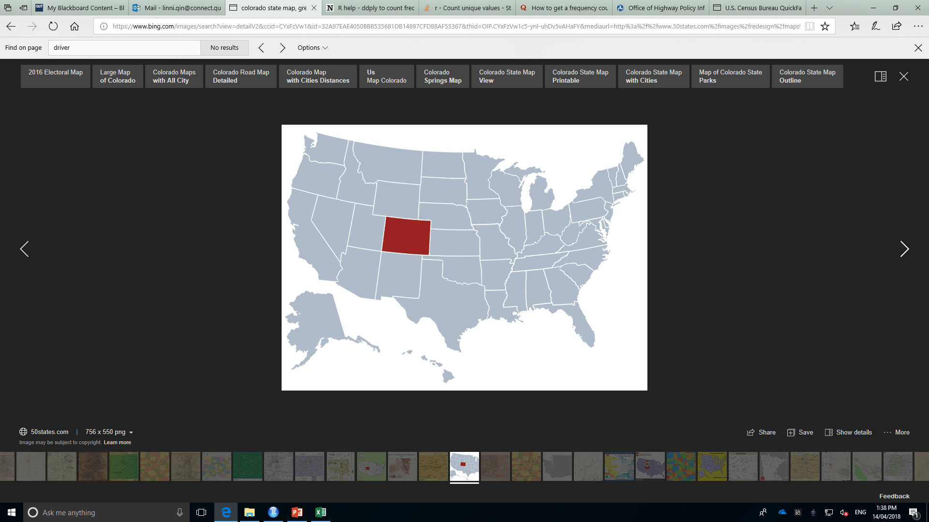
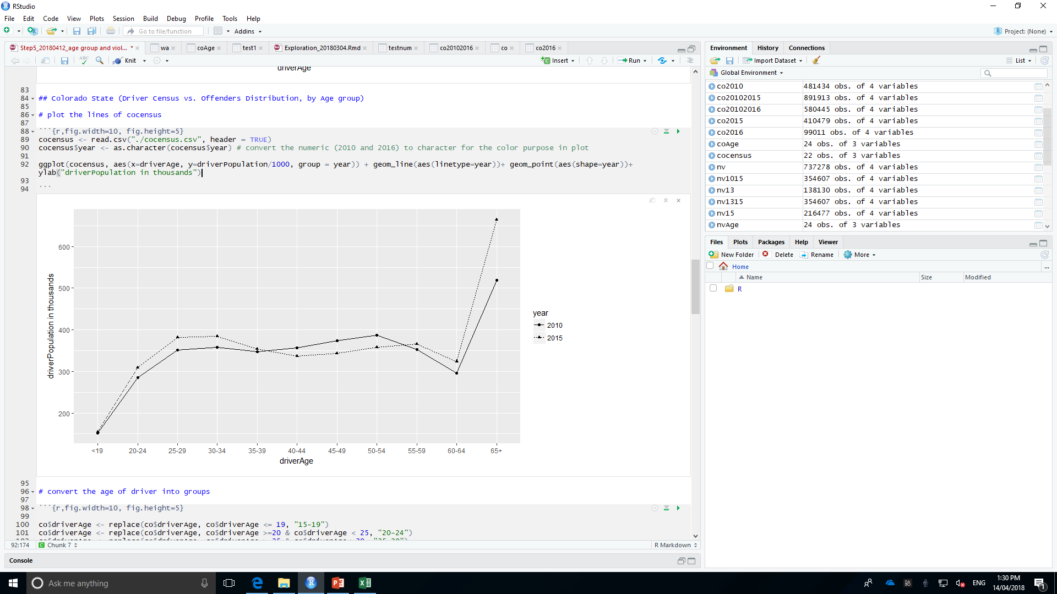
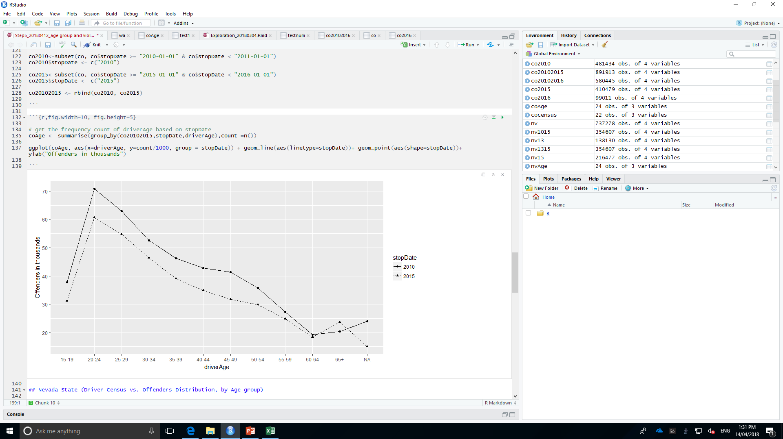
https://www.50states.com
Colorado State Licenced Drivers Demography, by Age Group (2010/2015)
Colorado State Traffic Offenders Distribution, by Age Group (2010/2015)
Total Licenced Driver: 3,974,521 (2015)
Total Offenders: 410,479 (2015)
Age group 20-24 contribute the highest traffic offending rate, then 25- 29.
It can be concluded that more elder the driver is, less offending behaviours.
The general patrol-stop rate obviously decreased from 2010 to 2015.
The licensed driver has a balanced distribution by age group excluding the one under 19 and over 60.

Slide 5
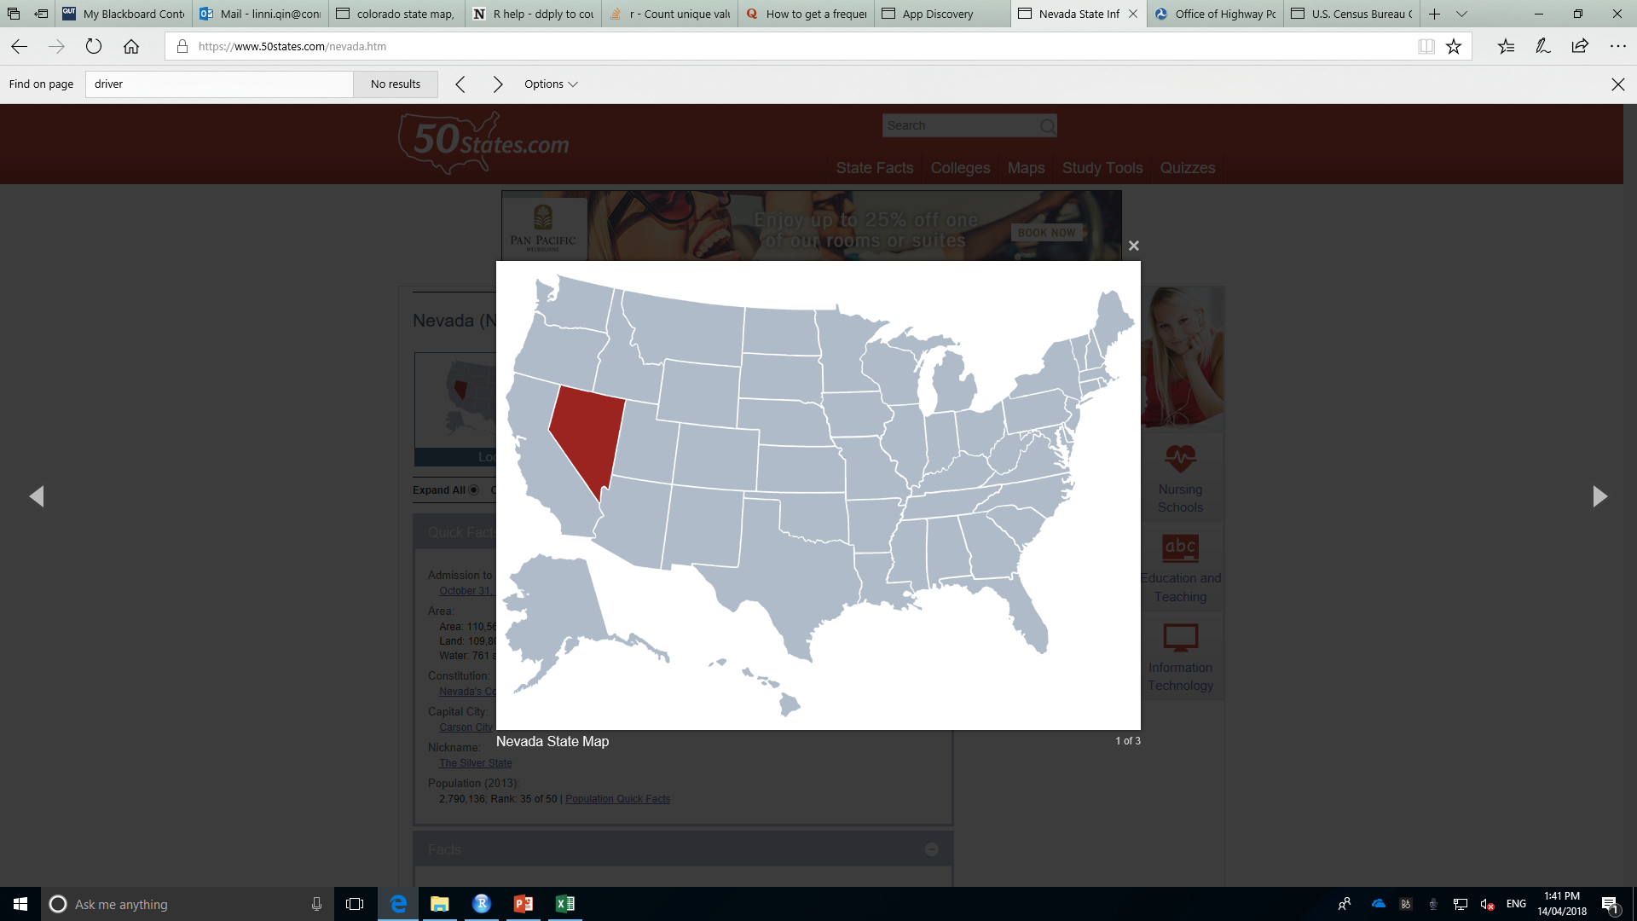
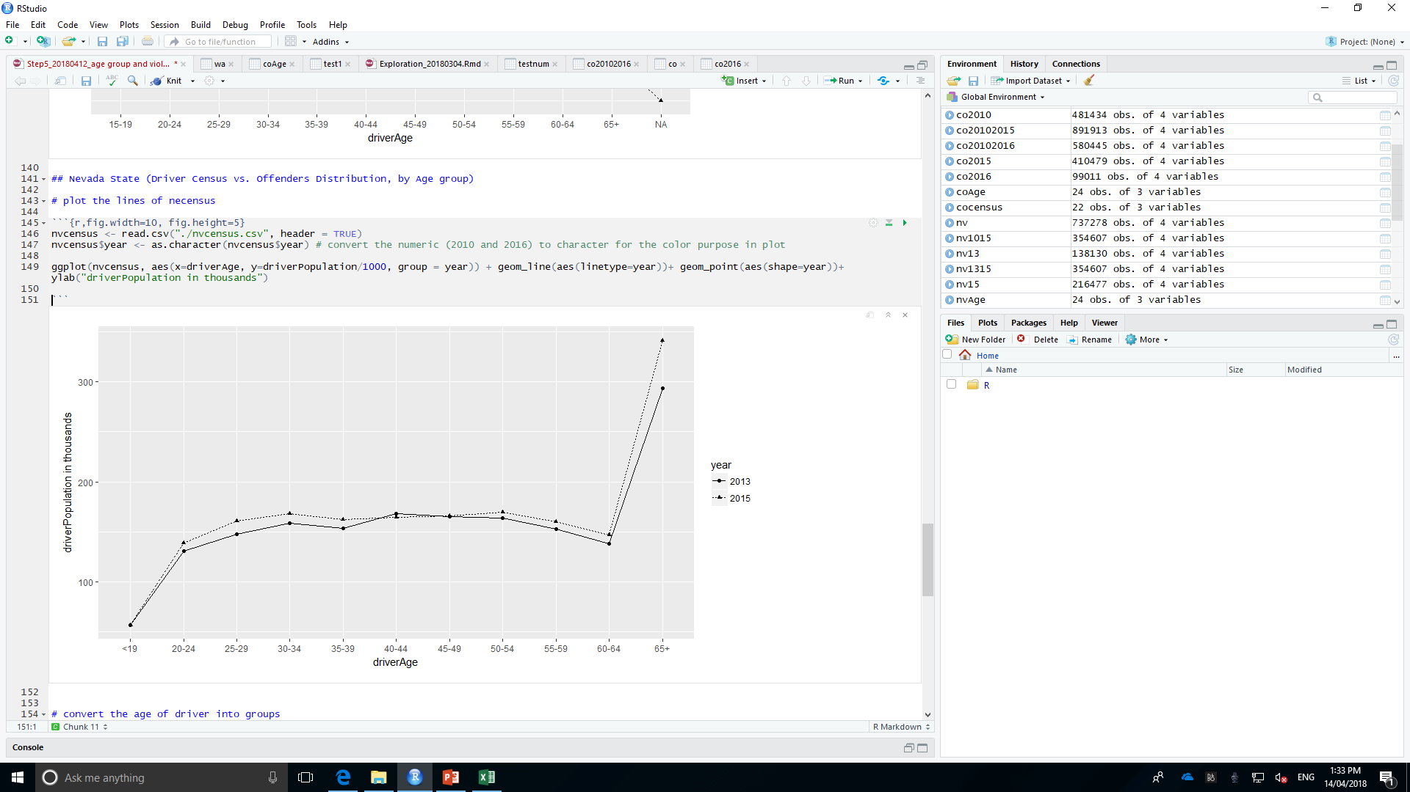
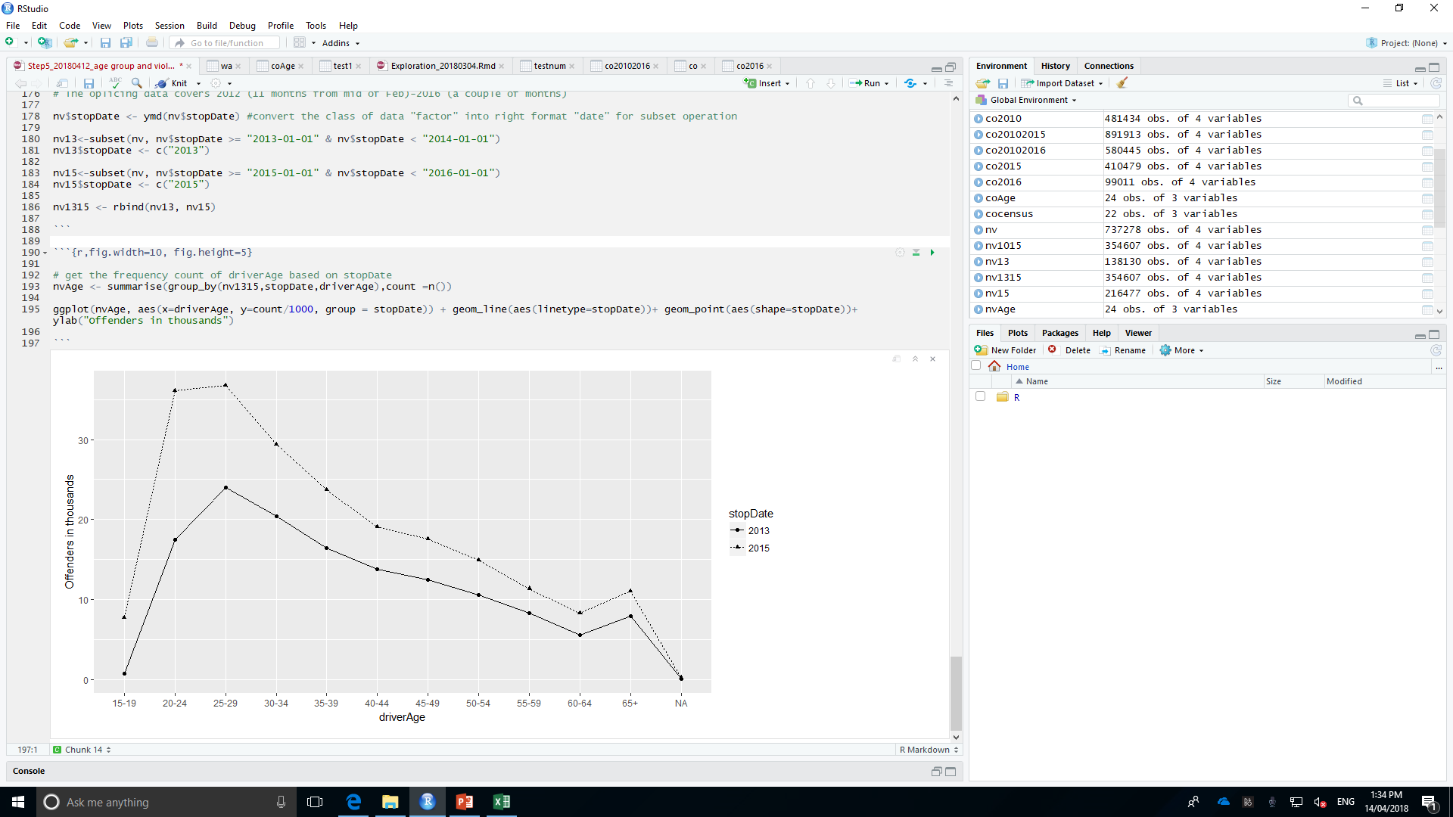
https://www.50states.com
Nevada State Licenced Drivers Demography, by Age Group (2012/2015)
Nevada State Traffic Offenders Distribution, by Age Group (2012/2015)
Total Offenders: 216,477 (2015)
Total Licenced Driver: 341,222 (2015)
The licensed driver has a balanced distribution by age group excluding the one under 19 and over 60.
The general patrol-stop rate apparently increased from 2013 to 2015.
Different with other two states, age group 25-29 resulted in the highest traffic offending behaviours and then 30-34.

Slide 6
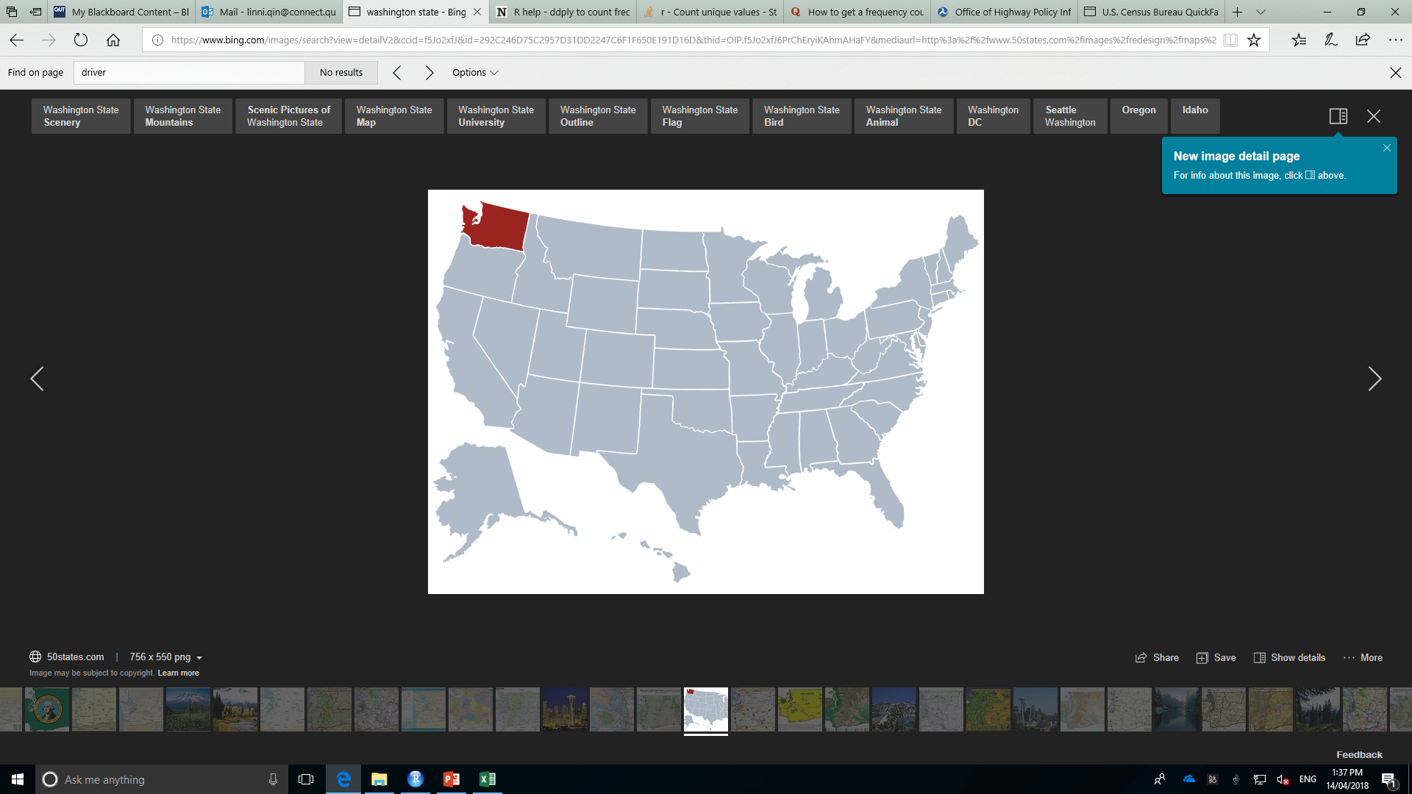
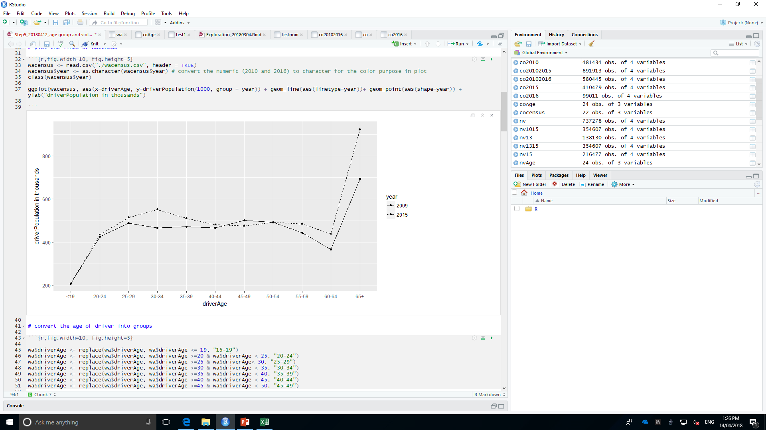
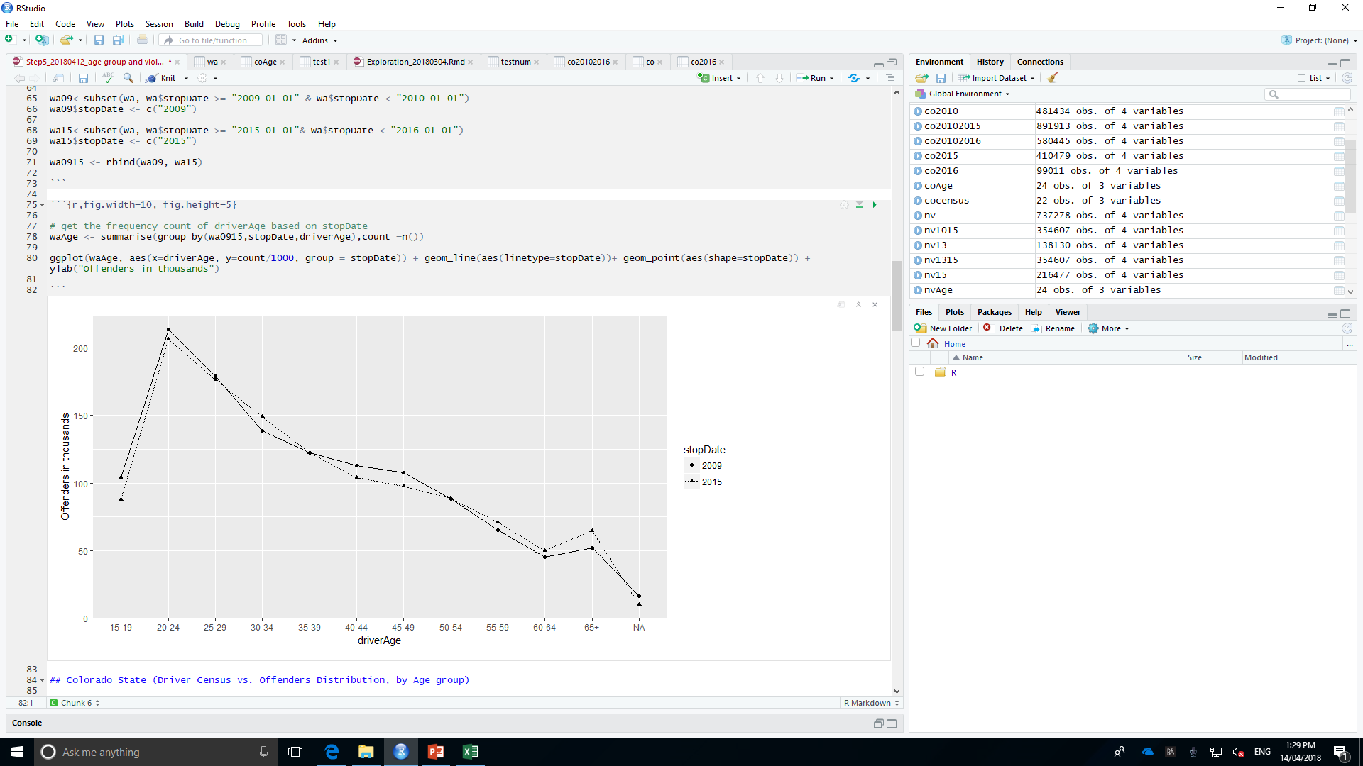
https://www.50states.com
Washington State Licenced Drivers Demography, by Age Group (2009/2015)
Washington State Traffic Offenders Distribution, by Age Group (2009/2015)
Total Licenced Driver: 5,516,134 (2015)
Total Offenders: 1,228,788 (2015)
The licensed driver has a balanced distribution by age group excluding the one under 19 and over 60.
Age group 20-24 contribute the highest traffic offending rate, then 25- 29.
It can be concluded that more elder the driver is, less offending behaviours.

Slide 7
Part II
General Violation Exploration
Washington Traffic Violation and Age Groups Distribution (2009 vs. 2015)
Colorado Traffic Violation and Age Groups Distribution (2010 vs. 2015)
Nevada Traffic Violation and Age Groups Distribution (2013 vs. 2015)

Slide 8
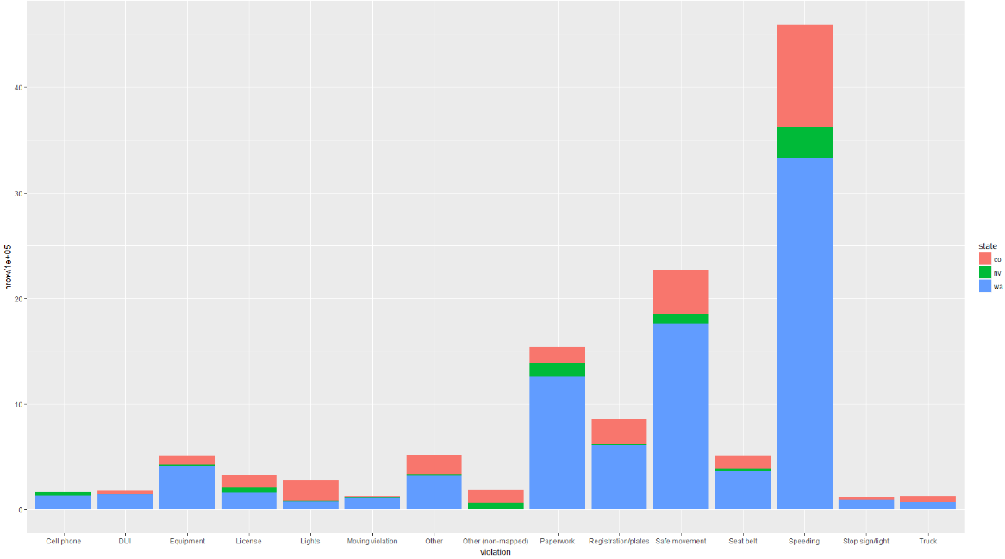
Top 3 Violations
Speeding
Safe Movement ( car wrecked) ???? Is Safe Movement (wrecked car) record resulted from speeding, dui, cell phone?
Paperwork ???? Is Paperwork involved with DUI or other traffic crimes?
Therefore, TO DO: Explore mainly the distribution of Speeding, DUI, Cell Phone with varied age groups

Slide 9
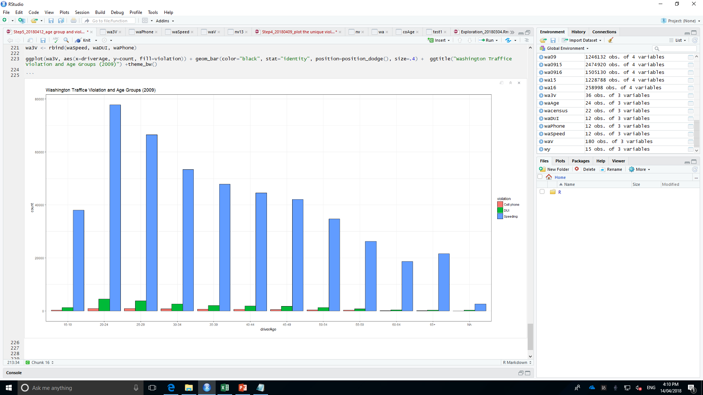
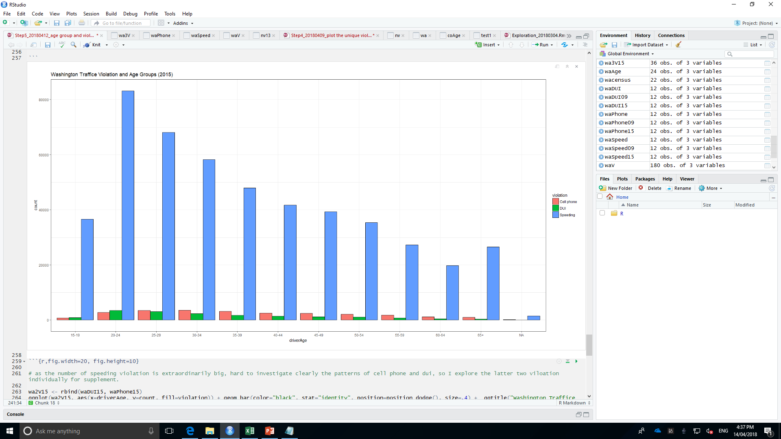
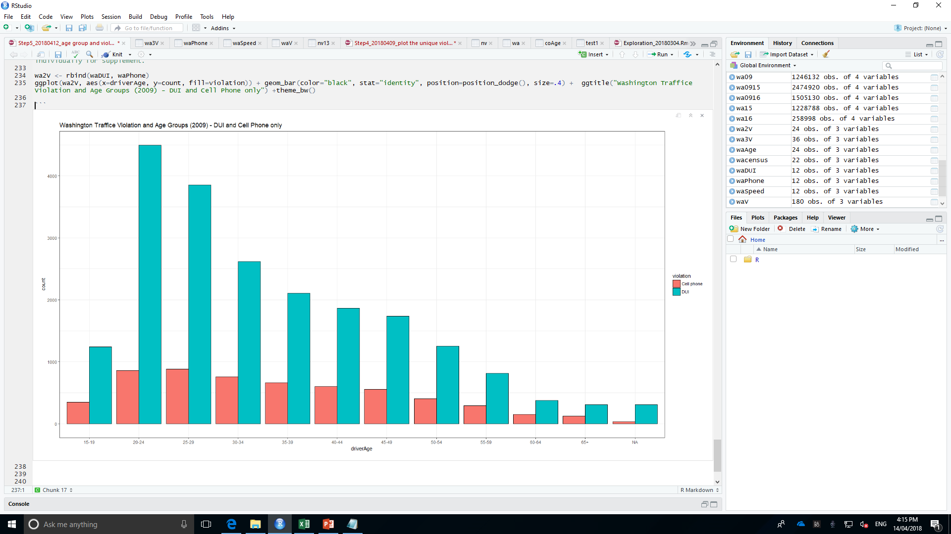
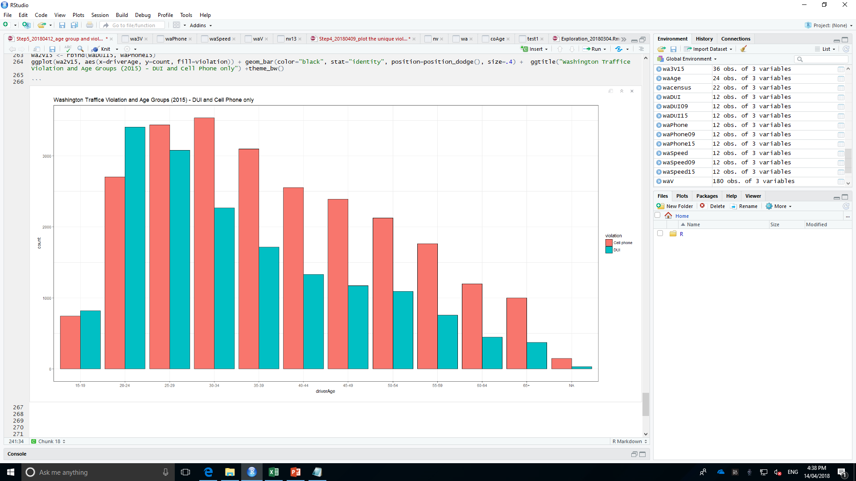
Washington Traffic Violation and Age Groups Distribution (2009 vs. 2015)
Violation | 2009 | 2015 | 2009 vs 2015
Speeding | Highest: 20-24 then 25- 29. More elder Less violation | Highest: 20-24 then 25- 29. More elder Less violation | 2009 < 2015 2009 = (1- 6%) * 2015
DUI | Highest: 20-24 then 25- 29. More elder Less violation DUI violation is around 5 TIMES of the amount of cell phone violation for the driver (20-24) | Highest: 20-24 then 25- 29. More elder Less violation | 2009 > 2015 (2009 = (1+33%) * 2015) (new DUI law, 28/9/2013)
Cell phone | Highest: 20-24 nearly = 25-29 It could be told that cell phone violation appears equally distribution among drivers from age 20-49. | Highest: 30-34 then 25- 29. From 35, more elder less violation | 2009 < 2015 (2015 = 3* 2009) (starting from 2012, smartphone overtook feature phone)

Slide 10
Washington Traffic Violation and Age Groups Distribution (2009)
Similarity exists between speeding and DUI violation, age group 20-24 contribute the highest rate, then 25- 29. It can be concluded that more elder the driver is, less offending behaviours relevant to speeding and dui.
Considering texting while driving, equal frequency of this behaviour spreads within drivers between 20-29. It decreasing very slightly when the age is increasing until 49. For the driver over than 50, it is nearly 1/3 reduction in the amount according to the next elder group. It could be told that cell phone violation appears equally distribution among drivers from age 20-49.
DUI violation is around 5 TIMES of the amount of cell phone violation for the driver (20-24).

Slide 11
Washington Traffic Violation and Age Groups Distribution (2015)
Speeding and DUI violation: Age 20-24 highest then 25- 29. More elder, less violation.
The distribution of DUI appears the same status but 1/3 less than the respective amount of 2009.
Cell phone violation boosted up to more than 3 TIMES of respective amount of 2009.
DUI violation is around 1/5 higher than the amount of cell phone violation for the driver under 24. Nevertheless, starting from driver aging 25, the driving distraction by the cell phone appears worse and worse than DUI.
Drivers (30-34) conduct the worst group related to cell pone

Slide 12
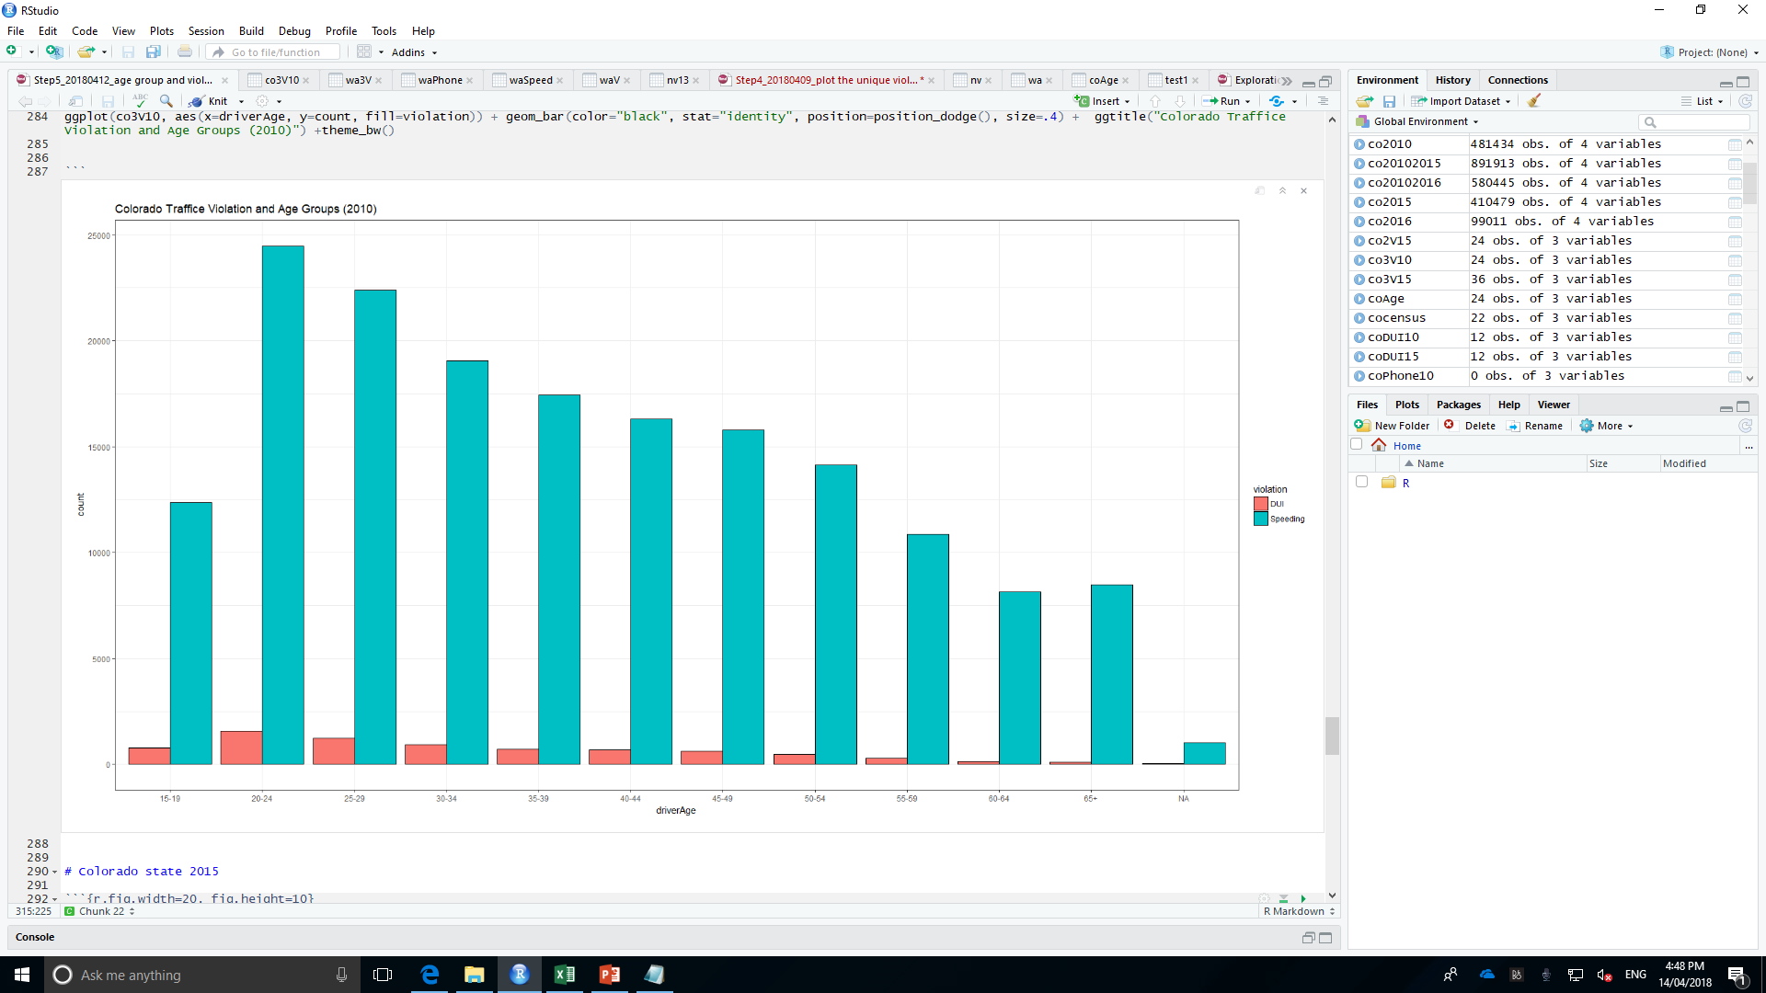
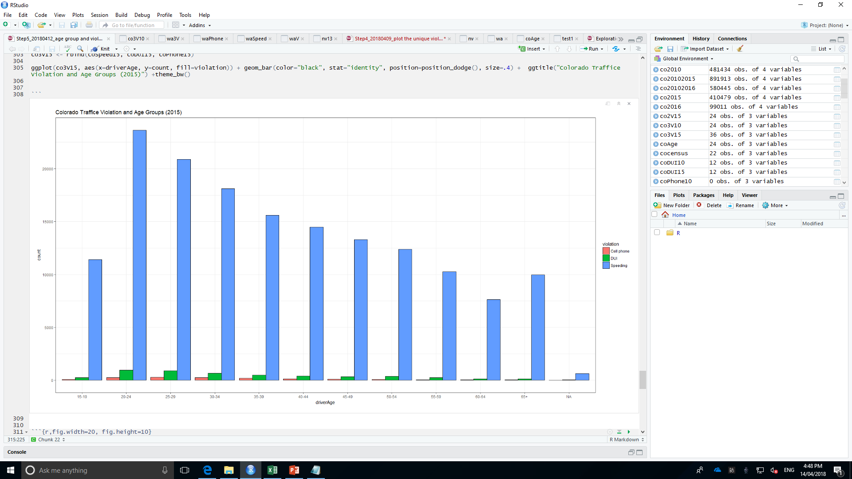
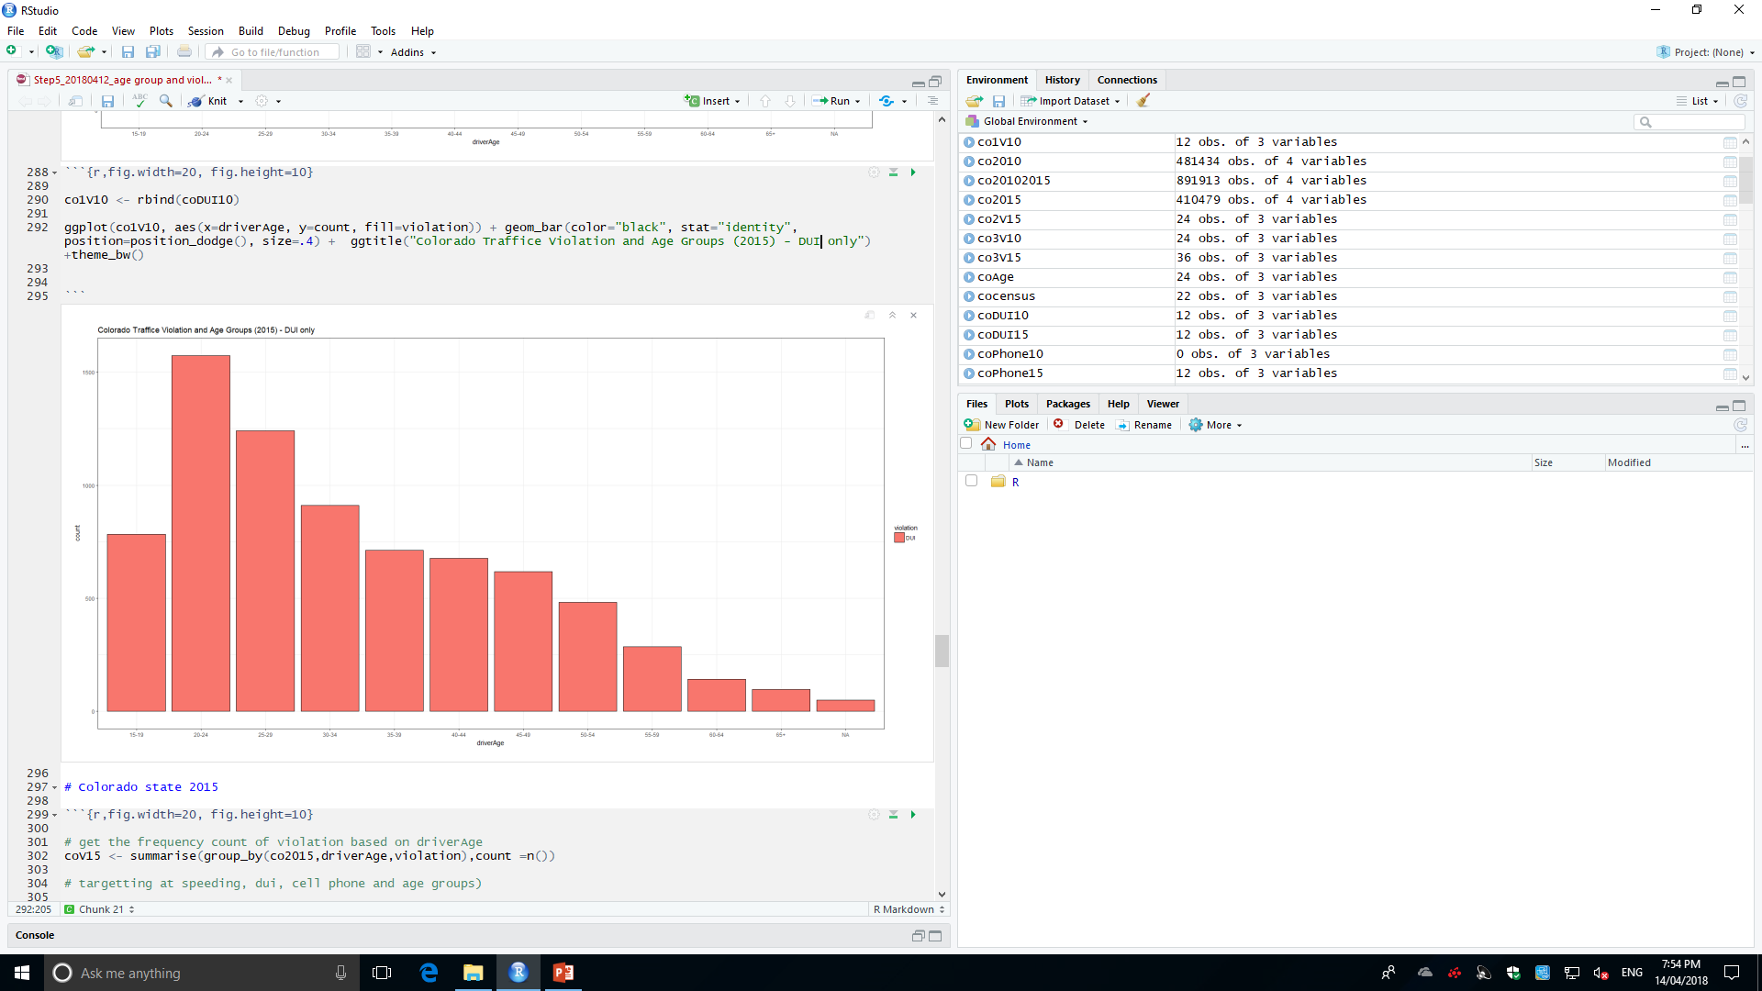
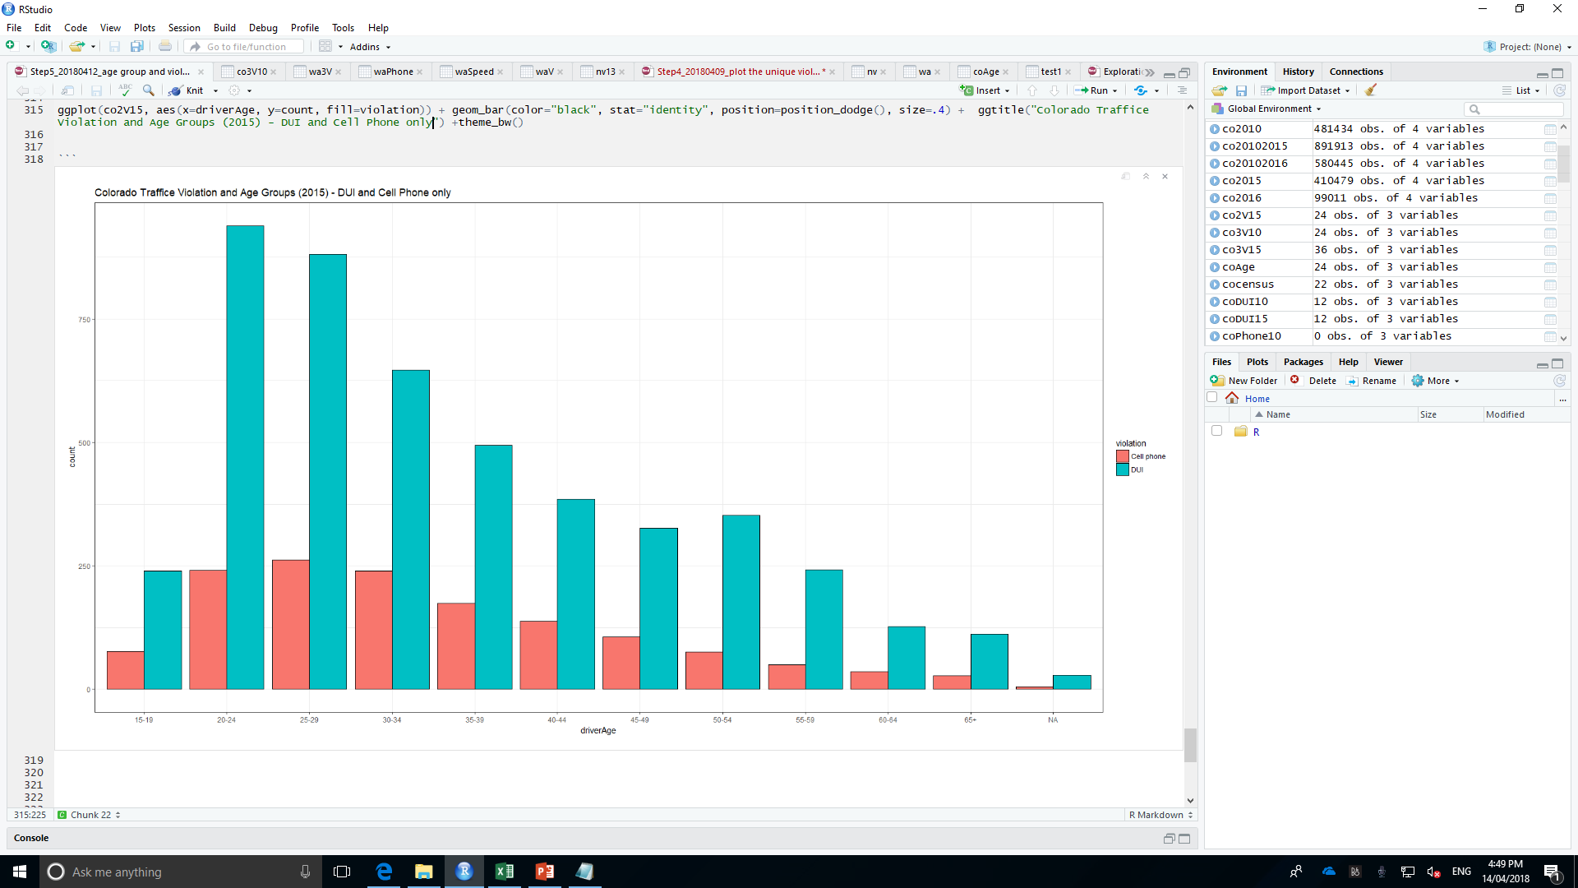
Colorado Traffic Violation and Age Groups Distribution (2010 vs. 2015)
Violation | 2010 | 2015 | 2009 vs 2015
Speeding | Highest: 20-24 then 25- 29. More elder Less violation | Highest: 20-24 then 25- 29. More elder Less violation
DUI | Highest: 20-24 then 25- 29. More elder Less violation | Highest: 20-24 then 25- 29. More elder Less violation
Cell phone | N/A | Highest: 25-29 Highest: 20-24 nearly = 30-34 >35 years old, the violation decreased gradually. | N/A

Slide 13
Colorado Traffic Violation and Age Groups Distribution (2010)
Similar with the distribution of Washington 2009. Speeding and DUI violation, age group 20-24 contribute the highest rate, then 25- 29. It can be concluded that more elder the driver is, less offending behaviours relevant to speeding and dui.
No record for cell phone violation in 2010.
DUI: Highest: 20-24 then 25- 29. More elder Less violation

Slide 14
Colorado Traffic Violation and Age Groups Distribution (2015)
Two charts presents similarly with those of Washington 2009.
Speeding and DUI violation: age group 20-24 contribute the highest rate, then 25- 29. It can be concluded that more elder the driver is, less offending behaviours relevant to speeding and dui.
Cell phone violation: Drivers (25-29) highest; Drivers (20-24, 30-34) take the second highest that contribute equally as the second mostly offenders. Starting from 35 years old, the violation decreased gradually.
DUI violation is around 5 TIMES of the amount of cell phone violation for the driver (20-24).

Slide 15
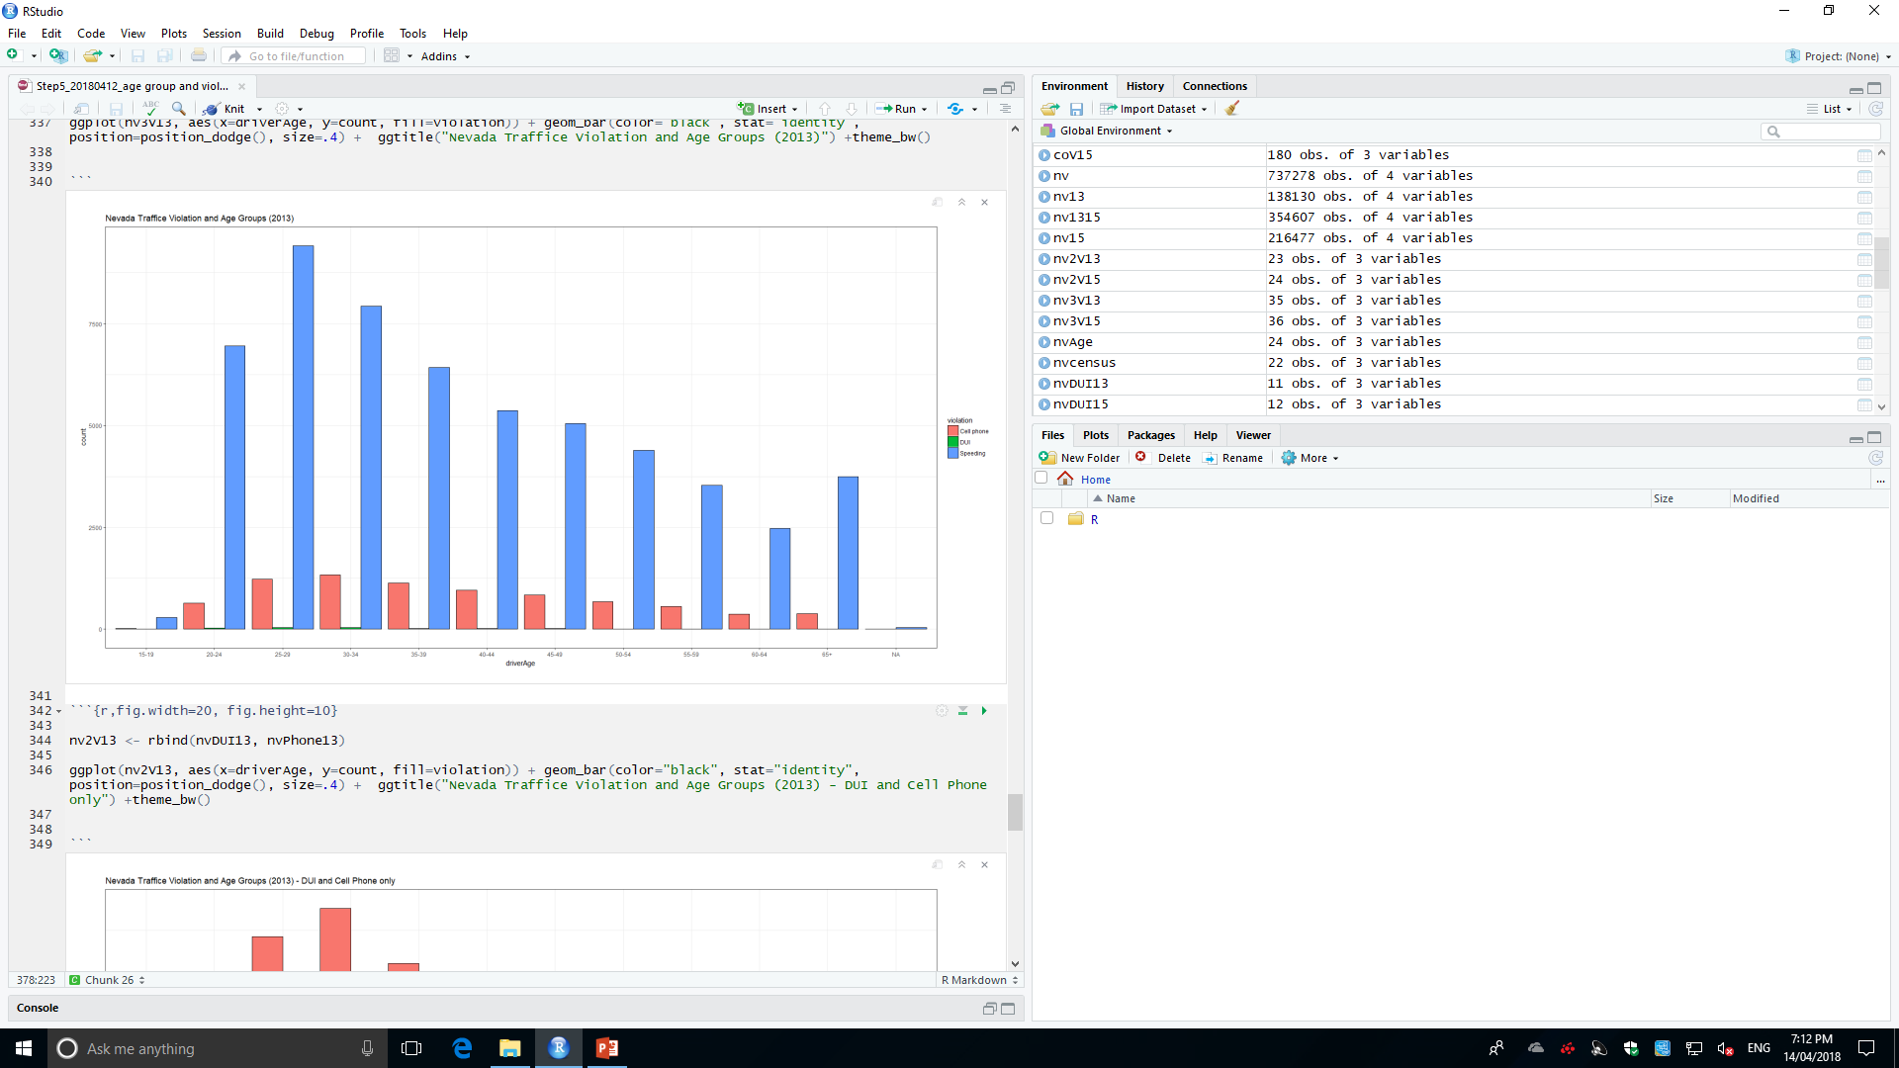
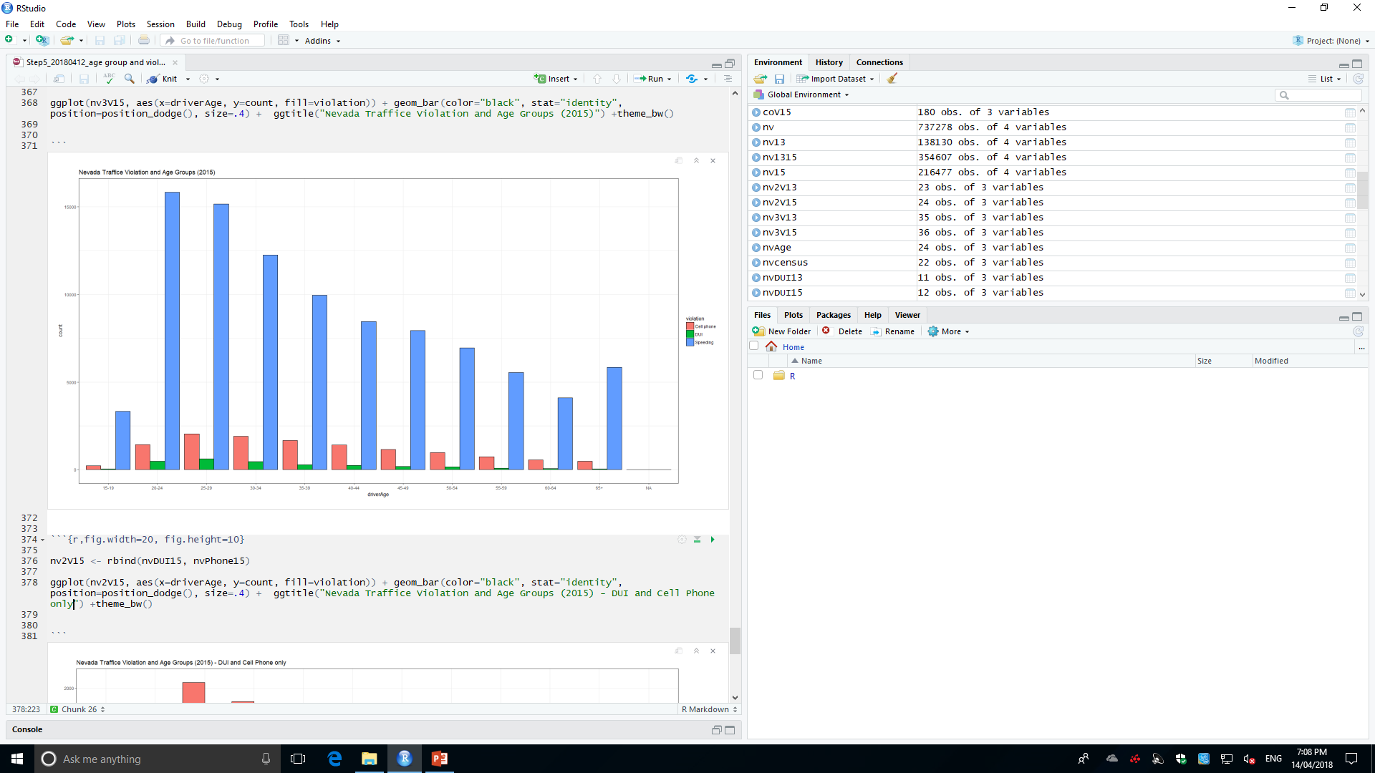
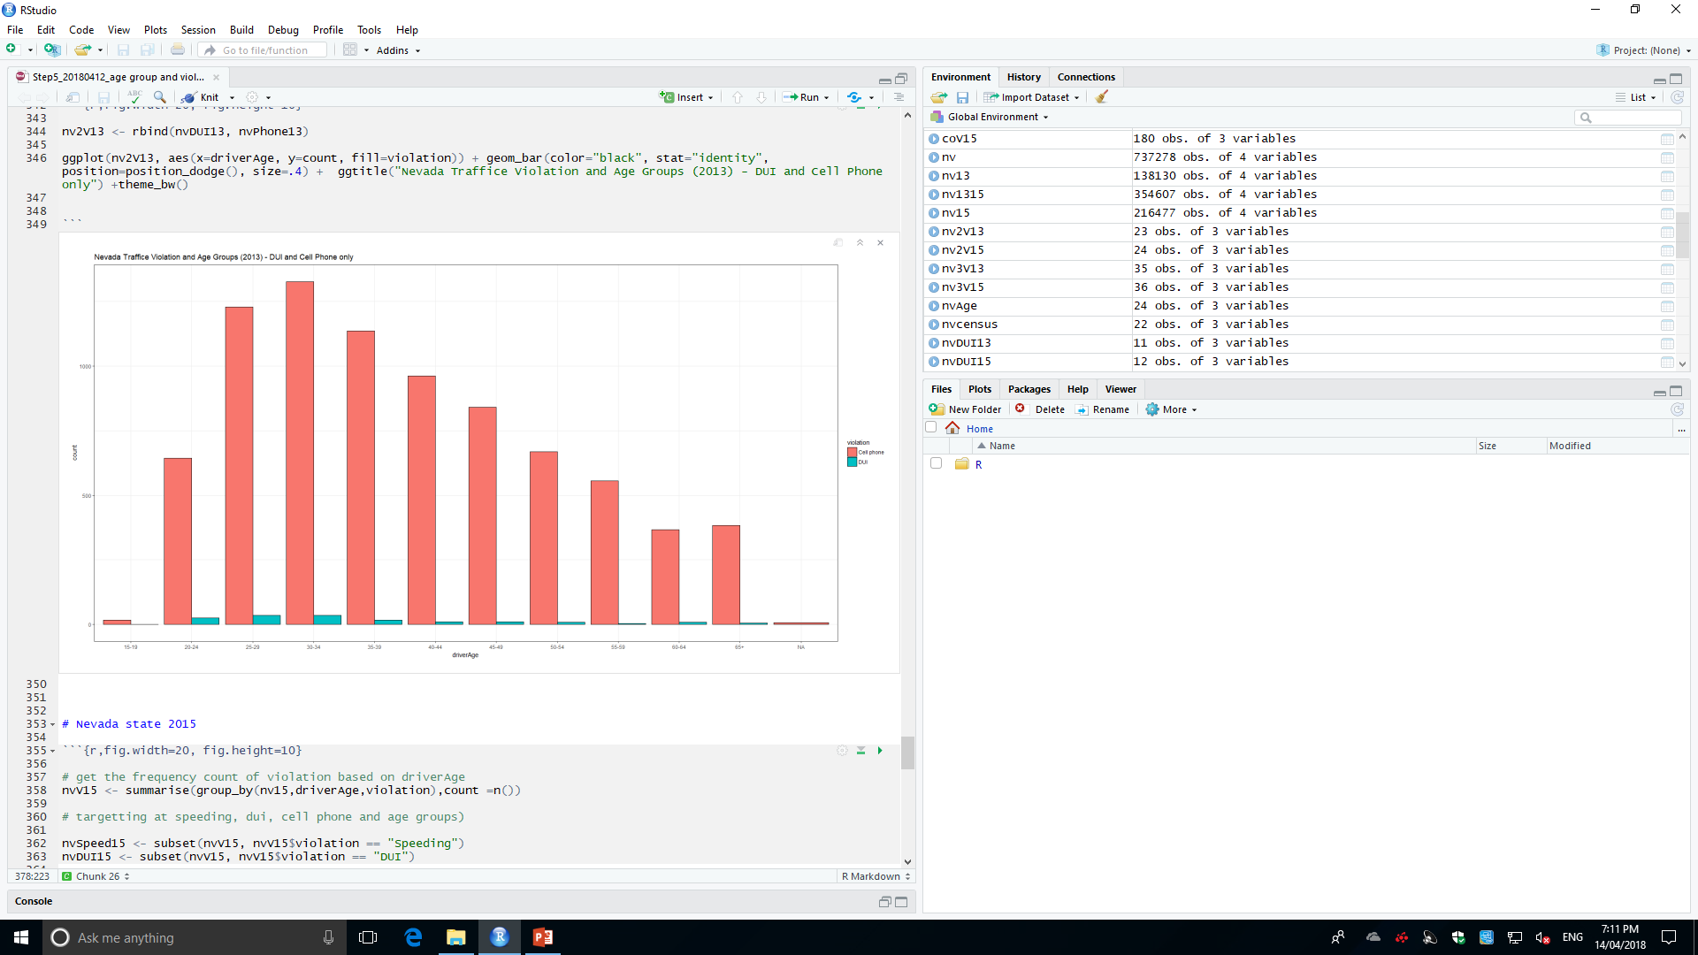
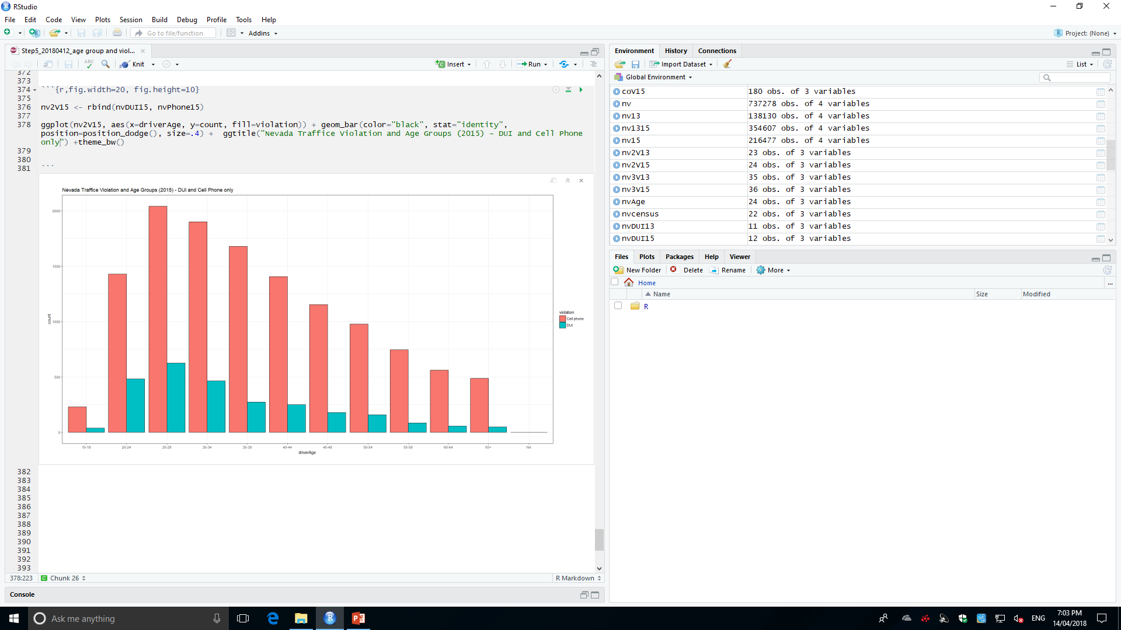
Nevada Traffic Violation and Age Groups Distribution (2013 vs. 2015)
Violation | 2010 | 2015 | 2009 vs 2015
Speeding | Highest: 20-24 then 25- 29. More elder Less violation | Highest: 20-24 then 25- 29. More elder Less violation
DUI | Highest: 20-24 then 25- 29. More elder Less violation | Highest: 20-24 then 25- 29. More elder Less violation | 2015 > 2009 (2015 = 500 * 2009)
Cell phone | N/A | Highest: 25-29 Highest: 20-24 nearly = 30-34 >35 years old, the violation decreased gradually. | 2015 > 2009 [2015 = (1+ 30%) * 2009]

Slide 16
Nevada Traffic Violation and Age Groups Distribution (2013)

Slide 17
Nevada Traffic Violation and Age Groups Distribution (2015)

